Slide 1
INTRODUCTION TO THE WORLD OF TECHNOLOGY
Faryal Shamsi
Lecturer Computer Science
Sukkur IBA University

Slide 2
Technology & You!
Computers in your home
Computers in education
Computers at your job
Computers on the go

Slide 3
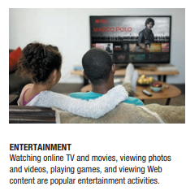
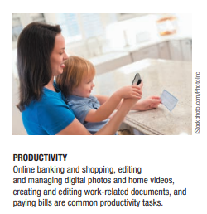
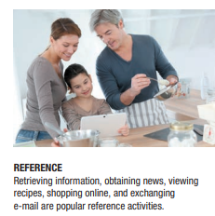
Computers in the Home

Slide 4
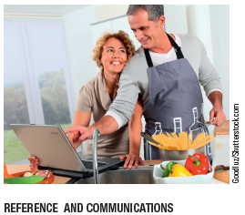
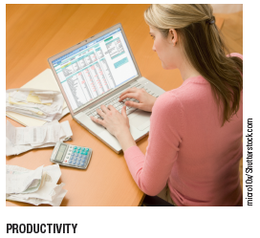
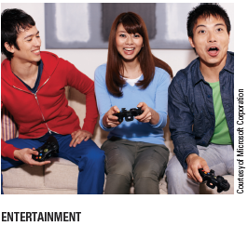
Computers in the Home

Slide 5
Computers in the Home
Convergence
The computer has become the central part of home entertainment
Dual-mode mobile phones
Wireless networking
Computers can be used in nearly any location
Smart appliances
Traditional appliances with built-in computer or communication technology
Smart homes
Household tasks are monitored and controlled by a main computer in the house

Slide 6
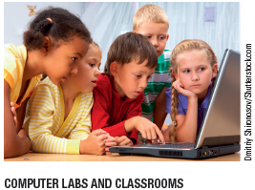
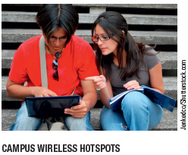
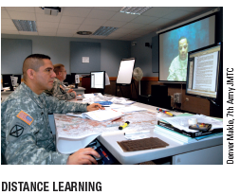
Computers in Education

Slide 7
Computers in Education
Youth today can be called the computing generation
Most students today have access to computers at school
Some schools integrate e-books into the curriculum
Colleges and universities are even more integrated
Wireless hotspots allow usage of personal laptops to connect to the college network
Some colleges require a computer for enrollment
Distance learning
Students participate from locations other than the traditional classroom setting using computers and Internet access

Slide 8
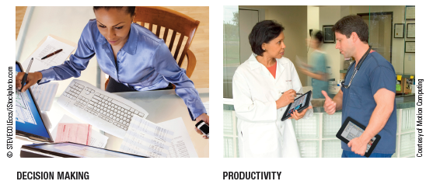
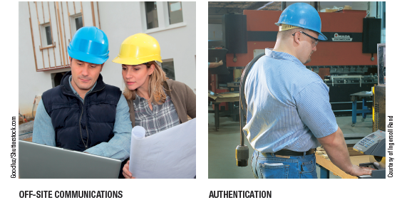
Computers on the Job

Slide 9
Computers on the Job
Computers have become a universal on-the-job tool for decision-making, productivity, and communication
Used by all types of employees
Used for access control and other security measures
Use by service professionals is growing
Used extensively by the military
Employees in all lines of work need to continually refresh their computer skills

Slide 10
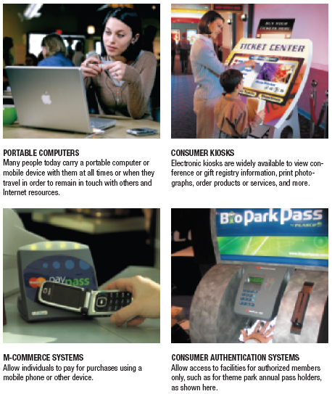
Computers on the Go

Slide 11
Computers on the Go
Computers are encountered in nearly every aspect of daily life
Consumer kiosks
ATM transactions
POS systems at retail stores
Self-checkout systems
Portable computers or mobile devices
M-commerce systems
GPS systems

Slide 12
COMPUTER HISTORY

Slide 13
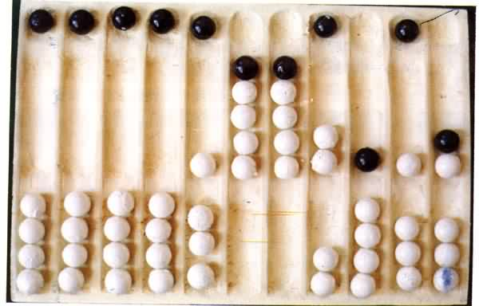
Year : 300 B.C
ABACUS

Slide 14
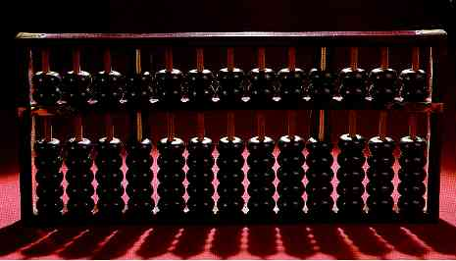
Modern Abacus
Note how the abacus is really just a representation of the human fingers: the 5 lower rings on each rod represent the 5 fingers and the 2 upper rings represent the 2 hands.

Slide 15
Year : 1617 A.D
Logarithms:
John Napier invented logarithms, which
are a technology that allows multiplication
to be performed via addition.

Slide 16
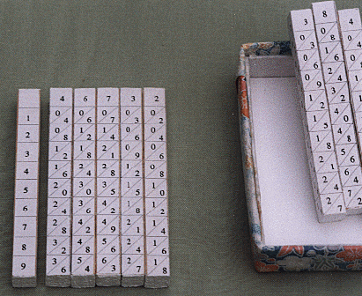
Napier’s Bones
The logarithm of each operand was originally obtained from a printed table, but Napier bones were alternative to tables, where the logarithm values were carved on ivory sticks .

Slide 17
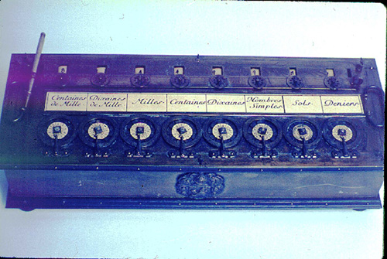
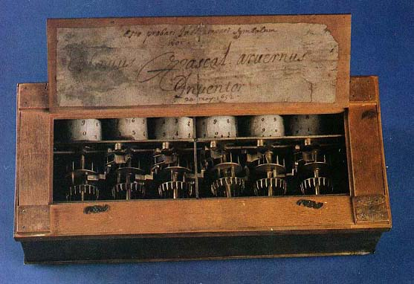
Year : 1642 A.D
Blaise Pascal, at age 19, invented the Pascaline as an aid for his father who was a tax collector.
Up until the present age when car dashboards went digital, the odometer portion of a car's speedometer used the very same mechanism as the Pascaline to increment the next wheel after each full revolution of the prior wheel.

Slide 18
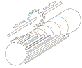
Just a few years after Pascal, the German Gottfried Wilhelm
Leibniz (co-inventor with Newton of calculus) managed to build a
four-function (addition, subtraction, multiplication, and division)
calculator that he called the stepped reckoner because, instead
of gears, it employed fluted drums having ten flutes arranged
around their circumference in a stair-step fashion.
Although the stepped reckoner employed the decimal number
system (each drum had 10 flutes), Leibniz was the first to
advocate use of the binary number system which is fundamental
to the operation of modern computers. Leibniz is considered one
of the greatest of the philosophers but he died poor and alone.

Slide 19
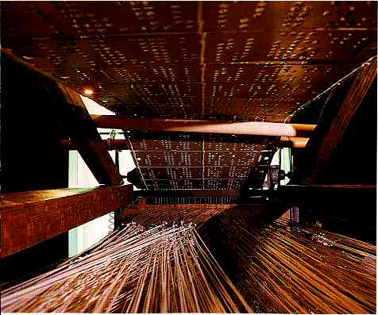
Year: 1801 A.D (Punch Cards)
The Frenchman Joseph Marie
Jacquard invented a power
loom that could base its weave
(and hence the design on the
fabric) upon a pattern
automatically read from
punched wooden cards, held
together in a long row by rope.

Slide 20
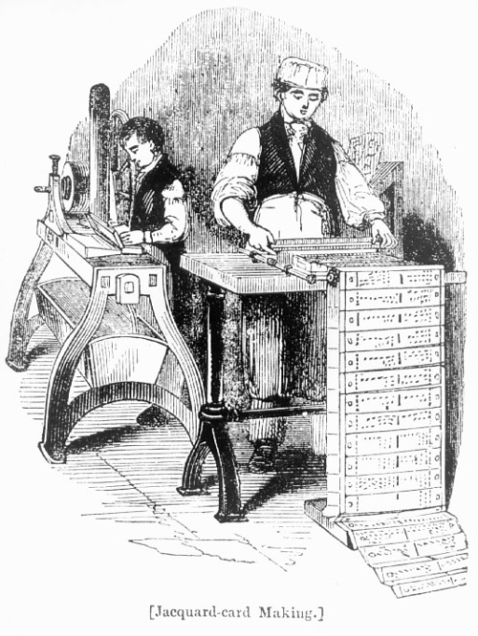
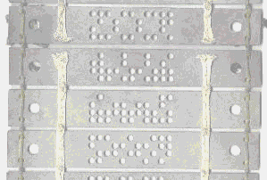
Punch card or Jacquard card
A closer look

Slide 21
Year : 1822 A.D
The English mathematician Charles Babbage was proposing a steam driven calculating machine the size of a room, which he called the Difference Engine. This machine would be able to compute tables of numbers, such as logarithm tables.

Slide 22
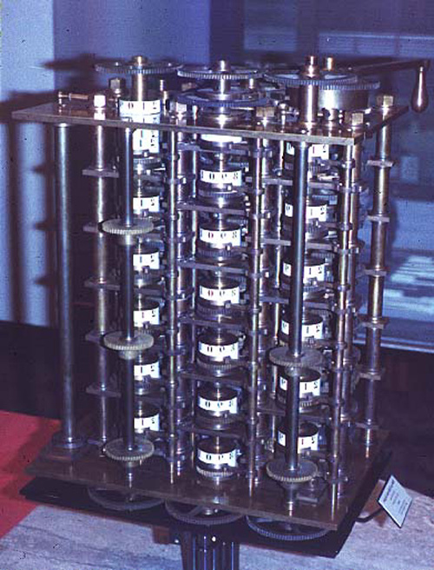
The Difference Engine
A small section of the type of mechanism employed in Babbage's Difference Engine [photo © 2002 IEEE]

Slide 23
Analytical Engine
This device, large as a house and powered by 6 steam engines, would be more general purpose in nature because it would be programmable, thanks to the punched card technology of Jacquard.
In the Jacquard loom, the presence or absence of each hole in the card physically allows a colored thread to pass or stops that thread (you can see this clearly in the earlier photo). Babbage saw that the pattern of holes could be used to represent an abstract idea such as a problem statement or the raw data required for that problem's solution. Babbage saw that there was no requirement that the problem matter itself physically pass thru the holes.

Slide 24
Analytical engine (ctd...)
Furthermore, Babbage realized that punched paper could be employed as a storage mechanism, holding computed numbers for future reference. Because of the connection to the Jacquard loom, Babbage called the two main parts of his Analytic Engine the "Store" and the "Mill", as both terms are used in the weaving industry. The Store was where numbers were held and the Mill was where they were "woven" into new results. In a modern computer these same parts are called the memory unit and the central processing unit (CPU).

Slide 25
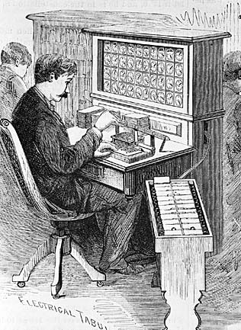
Year : 1890 A.D
Herman Hollerith's invention, known as the Hollerith desk, consisted of a card reader which sensed the holes in the cards, a gear driven mechanism which could count (using Pascal's mechanism which we still see in car odometers), and a large wall of dial indicators (a car speedometer is a dial indicator) to display the results of the count.

Slide 26
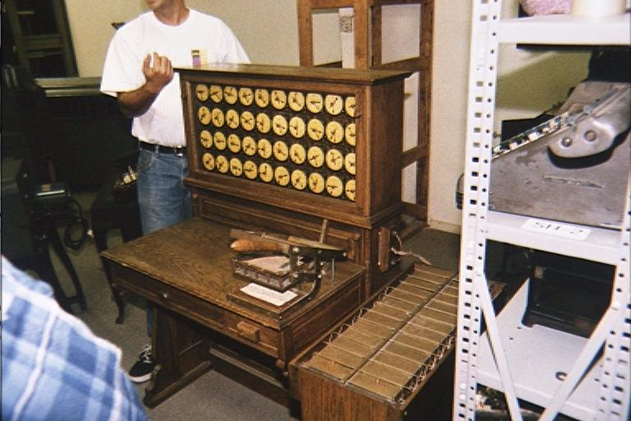
Hollerith desks still exist today

Slide 27
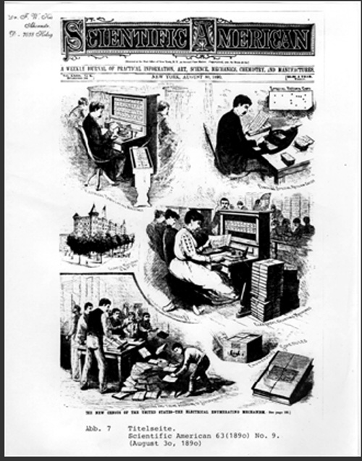
Hollerith and IBM
Incidentally, the Hollerith census machine was the first machine to ever be featured on a magazine cover.
Hollerith built a company, the Tabulating Machine Company which, after a few buyouts, eventually became International Business Machines, known today as IBM. IBM grew rapidly and punched cards became ubiquitous.

Slide 28
More about IBM
IBM continued to develop mechanical calculators for sale to businesses to help with financial accounting and inventory accounting.
One early success was the Harvard Mark I computer which was built as a partnership between Harvard and IBM

Slide 29
First Generation - 1940-1956
Major Innovation – Vacuum Tube
The first computers used vacuum tubes and were often enormous, taking up entire rooms.
They were very expensive to operate and in addition to using a great deal of electricity, generated a lot of heat, which was often the cause of malfunctions.
The UNIVAC and ENIAC computers are examples of first-generation computing devices.

Slide 30
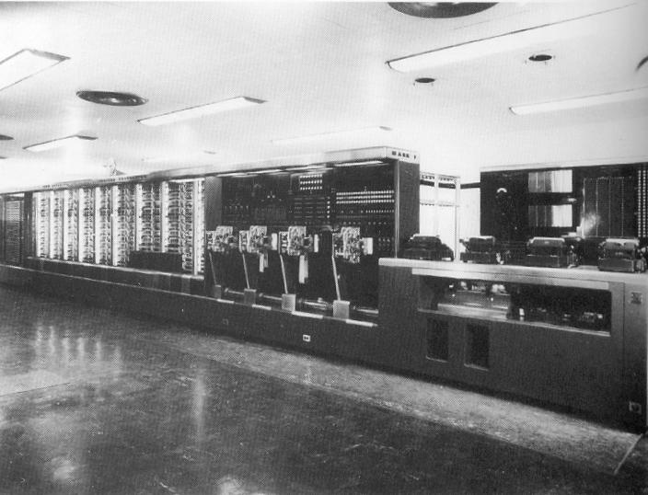
Mark 1

Slide 31
Mark 1
This was the first programmable digital computer made in the U.S.
It was not a purely electronic computer. Instead the Mark I was constructed out of switches, relays, rotating shafts, and clutches.
The machine weighed 5 tons, incorporated 500 miles of wire, was 8 feet tall and 51 feet long, and had a 50 ft rotating shaft running its length, turned by a 5 horsepower electric motor.
The Mark I ran non-stop for 15 years, sounding like a roomful of ladies knitting.

Slide 32
History of ‘Bug’
One of the primary programmers for the Mark I was a woman, Grace Hopper.
Hopper found the first computer "bug": a dead moth that had gotten into the Mark I and whose wings were blocking the reading of the holes in the paper tape.
The word "bug" had been used to describe a defect since at least 1889 but Hopper is credited with coining the word "debugging" to describe the work to eliminate program faults.

Slide 33
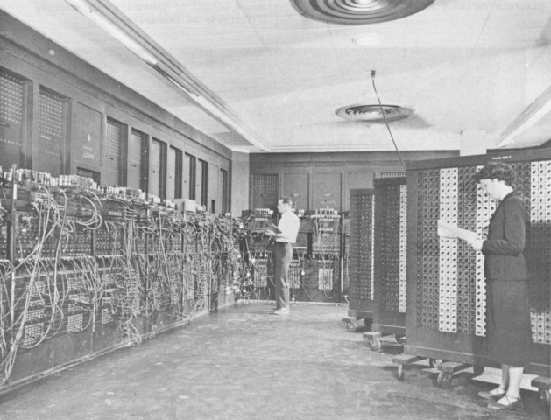
Year : 1943 – 1945
The first electronic digital computer ENIAC (Electronic Numerical Integrator and Calculator)
ENIAC was built by two professors, John Mauchly and J. Presper Eckert at the University of Pennsylvania

Slide 34
Second Generation - 1956-1963:
Major Innovation – Transistor
The transistor was far superior to the vacuum tube, allowing computers to become smaller, faster, cheaper, more energy-efficient and more reliable than their first-generation predecessors.
Though the transistor still generated a great deal of heat that subjected the computer to damage, it was a vast improvement over the vacuum tube. Second-generation computers still relied on punched cards for input and printouts for output.
The first computers of this generation were developed for the atomic energy industry.

Slide 35
Third Generation - 1964-1971
Major Innovation – Integrated Circuits / IC
The development of the Integrated Circuits was the hallmark of the third generation of computers.
Transistors were miniaturized and placed on semi conductor chips, called IC, which drastically increased the speed and efficiency of computers.
Instead of punched cards and printouts, users interacted with third generation computers through keyboards and monitors and interfaced with an operating system
Computers for the first time became accessible to a mass audience because they were smaller and cheaper than their predecessors

Slide 36
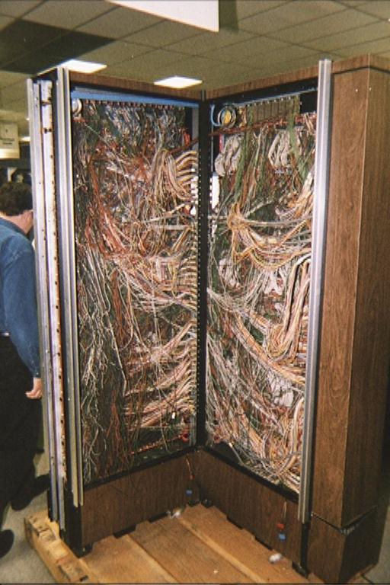
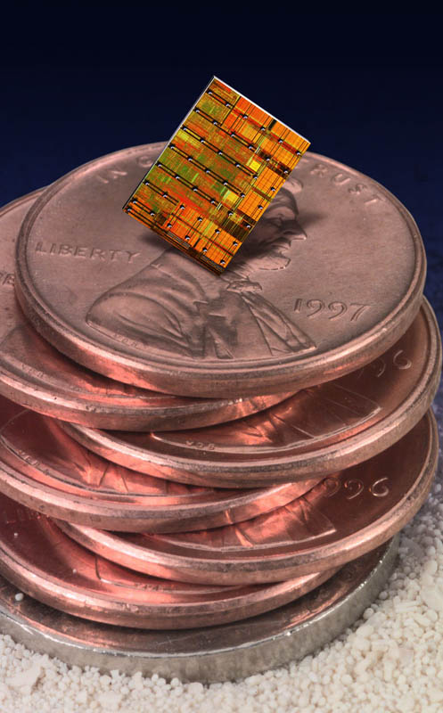
Revolution of IC

Slide 37
Fourth Generation - 1971-Present
Major Innovation – Microprocessor
Microprocessor is defined as thousands of integrated circuits were built onto a single silicon chip.
In 1981 IBM introduced its first computer for the home user
In 1984 Apple introduced the Macintosh.
As these small computers became more powerful, they could be linked together to form networks, which eventually led to the development of the Internet.

Slide 38
Fifth Generation - Present and Beyond
Major Innovation – Artificial Intelligence
Computers with intelligence like a human being
Robotics
Pattern Recognition
Simulation
Virtual Reality
Augmented Reality
Expert Systems
Machine Learning and Deep Learning
Generative AI Etc.

Slide 39
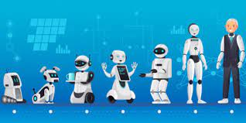
Robotics
Robotics is a branch of engineering and computer science that involves the conception, design, manufacture and operation of robots. The objective of the robotics field is to create intelligent machines that can assist humans in a variety of ways.

Slide 40
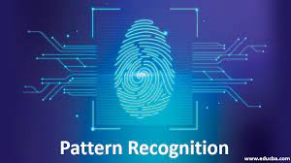
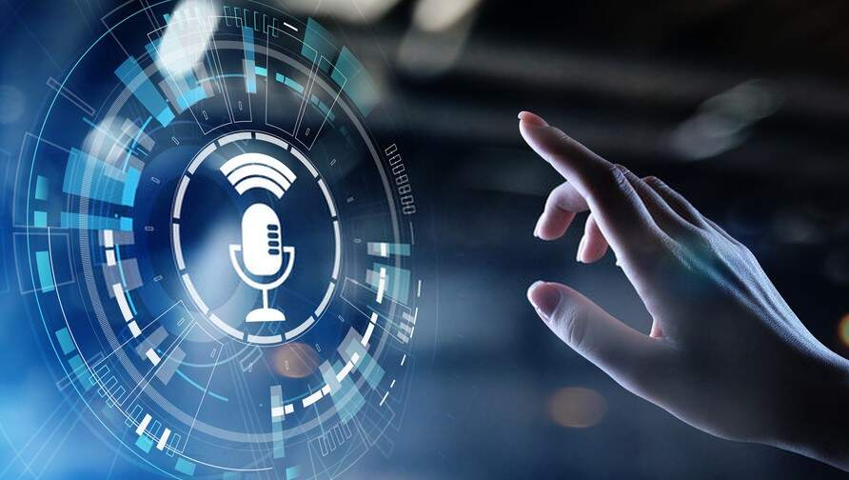
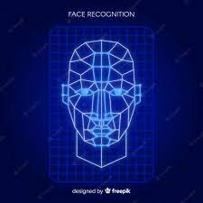
Pattern Recognition

Slide 41
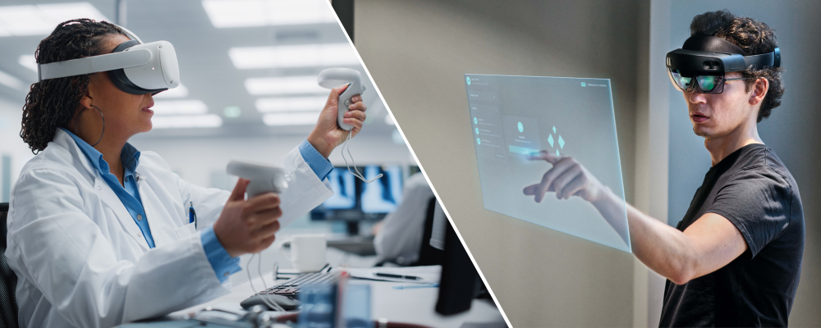
Simulation → Virtual → Augmented Reality Reality

Slide 42
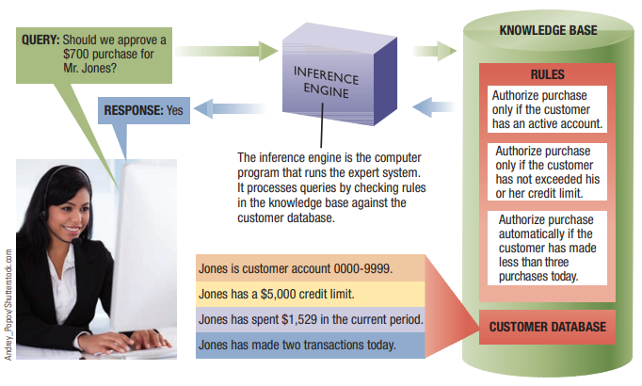
Expert System

Slide 43
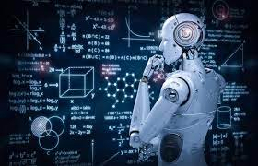
Machine Learning

Slide 44
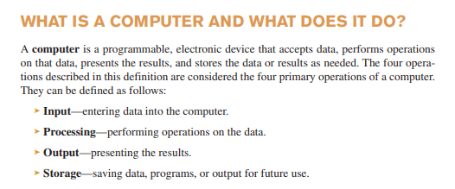

Slide 45
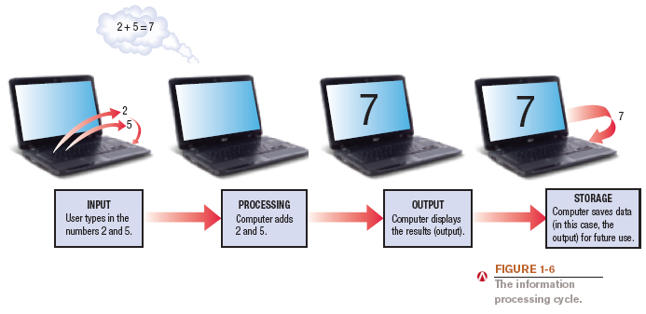
What Is a Computer and What Does It Do?

Slide 46
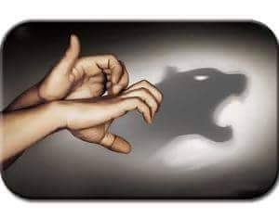
Processing VS Calculations
Computer processing may seem to be like Internet surfing, multimedia, audio/video streaming, gaming.
Internally, its nothing both calculation

Slide 47
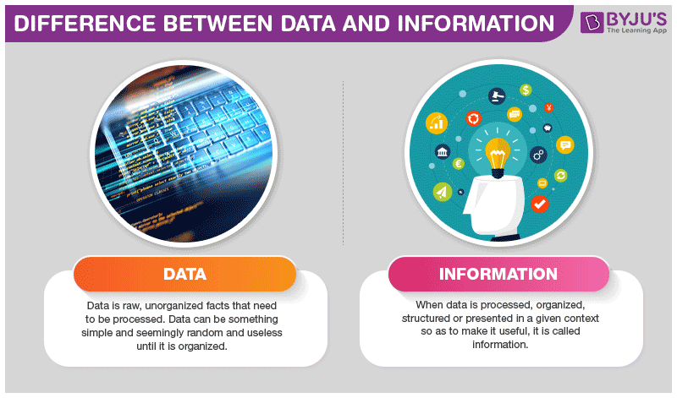

Slide 48
Types of Computer
Analog Computers
An analog computer is a form of computer that uses the continuous signals
physical quantities are used to measure data
Digital Computers
A digital computer is a form of computer that uses discrete or discontinuous signals
Current or Digits (0/1) are used to count data
Hybrid Computers –
Combination of Digital and Analog

Slide 49
Types of Digital Computer
Multiuser / Used by Organizations
Super Computer
Mainframe or Macro Computer
Mini Computers / Servers
Workstation
Etc.

Slide 50
Types of Personal Computer
Micro Computers / Used by Individual users
Personal Computer
Desktop PC
Tower PC
Laptop Computer
Notebook Computer
Tablet PC
Palmtop Computer
PDAs – Personal Digital Assistant

Slide 51
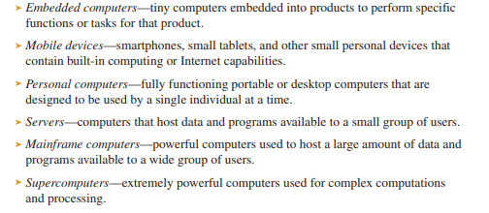
Various types of Computer

Slide 52
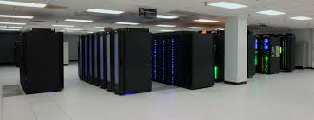
Super Computer
A supercomputer is a computer that performs at or near the currently highest operational rate for computers. Traditionally, supercomputers have been used for scientific and engineering applications that must handle very large databases or do a great amount of computation.

Slide 53
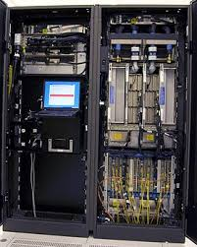
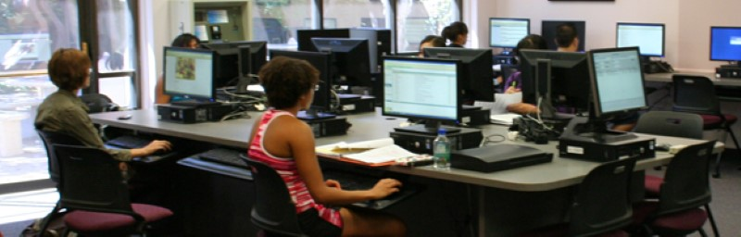
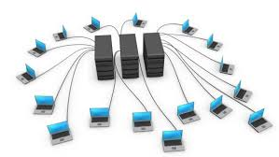
Mainframe and Mini Computer
Mainframe computers are computers used by large organizations for bulk data processing, such as census, industry and consumer statistics.

Slide 54
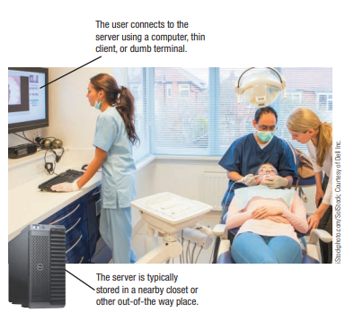
Server / Mid-range / Mini Computer
Mini Computer is smaller and less expensive
version of Mainframe Computer.
Thin Clients / Dumb Terminal
Thick Clients / Fat Clients / Intelligent Terminal

Slide 55
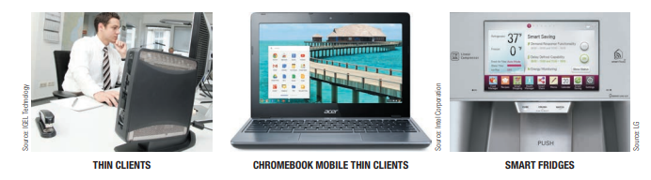
Thin Client Computers

Slide 56
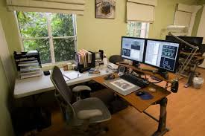
Workstation
A workstation is a special computer designed for technical or scientific applications. Intended primarily to be used by one person at a time, they are commonly connected to a local area network and run multi-user operating systems.

Slide 57
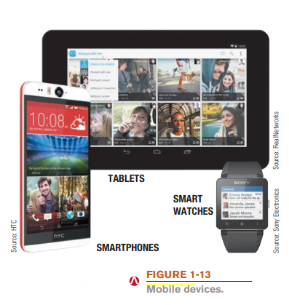
Mobile Devices

Slide 58
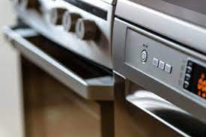



Embedded Computers

Slide 59
Parts of Computer
Hardware
Software

Slide 60

Hardware

Slide 61

Hardware

Slide 62
Software
System Software
Application Software
Utility Software

Slide 63

System Software – Windows

Slide 64

Application-Software Examples

Slide 65
Risks of Technology Oriented Society
Privacy
Security
Anonymity
Information Integrity
Communication Net - etiquette

